Slide 1
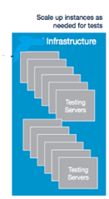
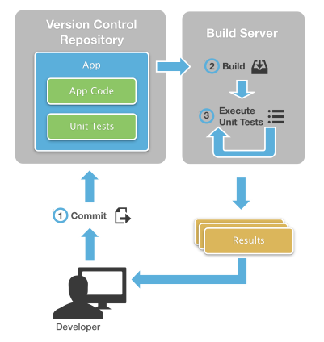

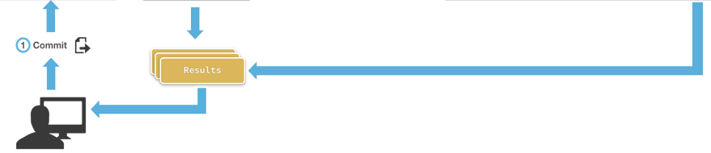
Current Product testing architecture by Infosys
Automated unit testing
Automated Functional testing
Bit Bucket
Jenkins CI
Test automation code
Build tests
Test data
Upload to Test Cloud
Test Configuration
Run automated tests at 8pm everyday in VDIs or cloud
Tester

Slide 2
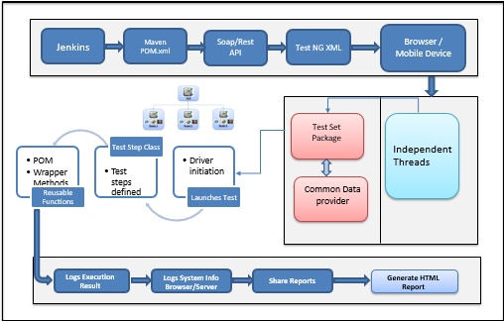
Proposed Automation architecture
Web application build in JAVA and framework designed as per DBS requirement
In the source code, every class represents a page in the application.
Common Data provider to set the Test Environment & Compatible to test both Desktop Browsers and Mobile web & App
Tools to be used
Jenkins- Scheduler/Trigger the scripts
Maven- Dependency update
Selenium Grid - Parallel execution
TestNG – Annotation to define the execution priority
Eclipse- IDE
SOAP/Rest API – Data dependency
Validation of content, Image handled using distributed test execution

Slide 3
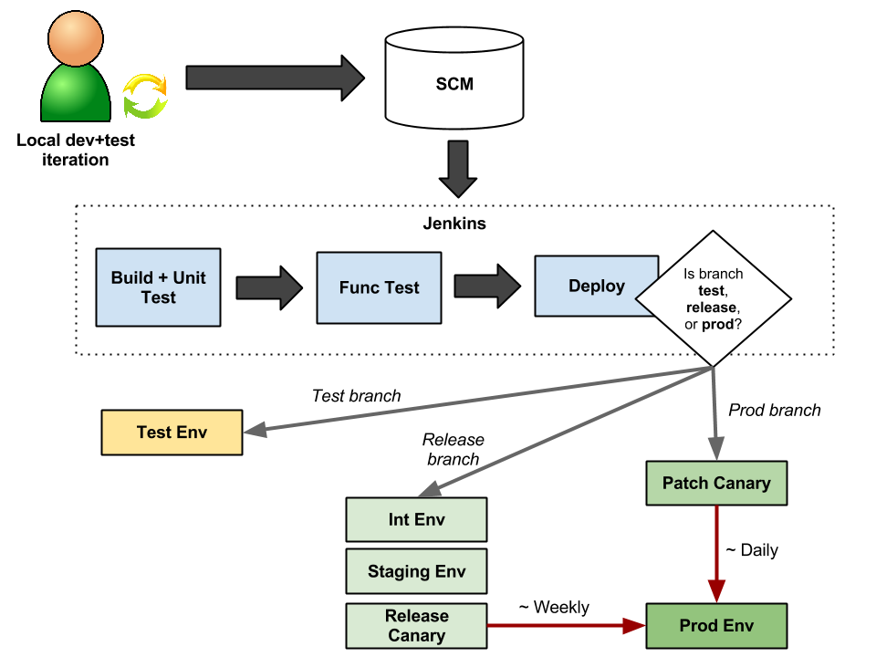
Proposed architecture for enabling continuous testing
.
Check-in
Trigger CI System
Jenkins
Build
Package
Deploy
Log Defect
HP-ALM
JIRA
Trigger Automated test scripts
HP-ALM
JIRA
Excel
…..
Automation Framework
Import Test Case
Export Report
Import
Execute
Defect
Report
Selenium
SeeTest
Appium
…..
Import Test Script
App under test / Device under test
HP-ALM
JIRA
Dashboard
Excel

Slide 4
Automation Dependencies
Platform - Any (Mac, Linux/Unix, Windows 7,8,10).
Development Environment - Eclipse IDE
Browsers - Chrome, IE(on Windows only), Firefox, Safari (on Mac only).
Language - Java 8
Build Tool - Maven
Continuous Integration Tool - Jenkins
Code Repository - SVN/ Gitlab etc.,
Jars Required - Selenium Server, Selenium Jars, TestNG can be got from Maven Dependency
Test Data for the identified POC test cases

